Slide 1

Evaluation of Various Sensing Modalities for Accurate Measurement of Neck Flexion Angle during Thyroid and Ear Surgery
CIS II Project
Team Member : Zhen Hu, Hanqing Duan
Mentor: Dr. Russell Taylor, Dr. Deepa Galaiya

Slide 2
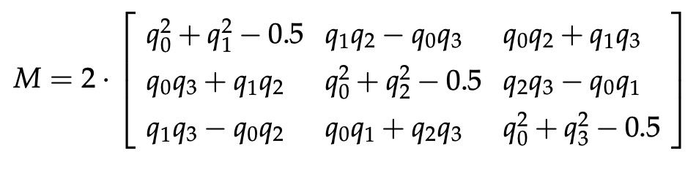
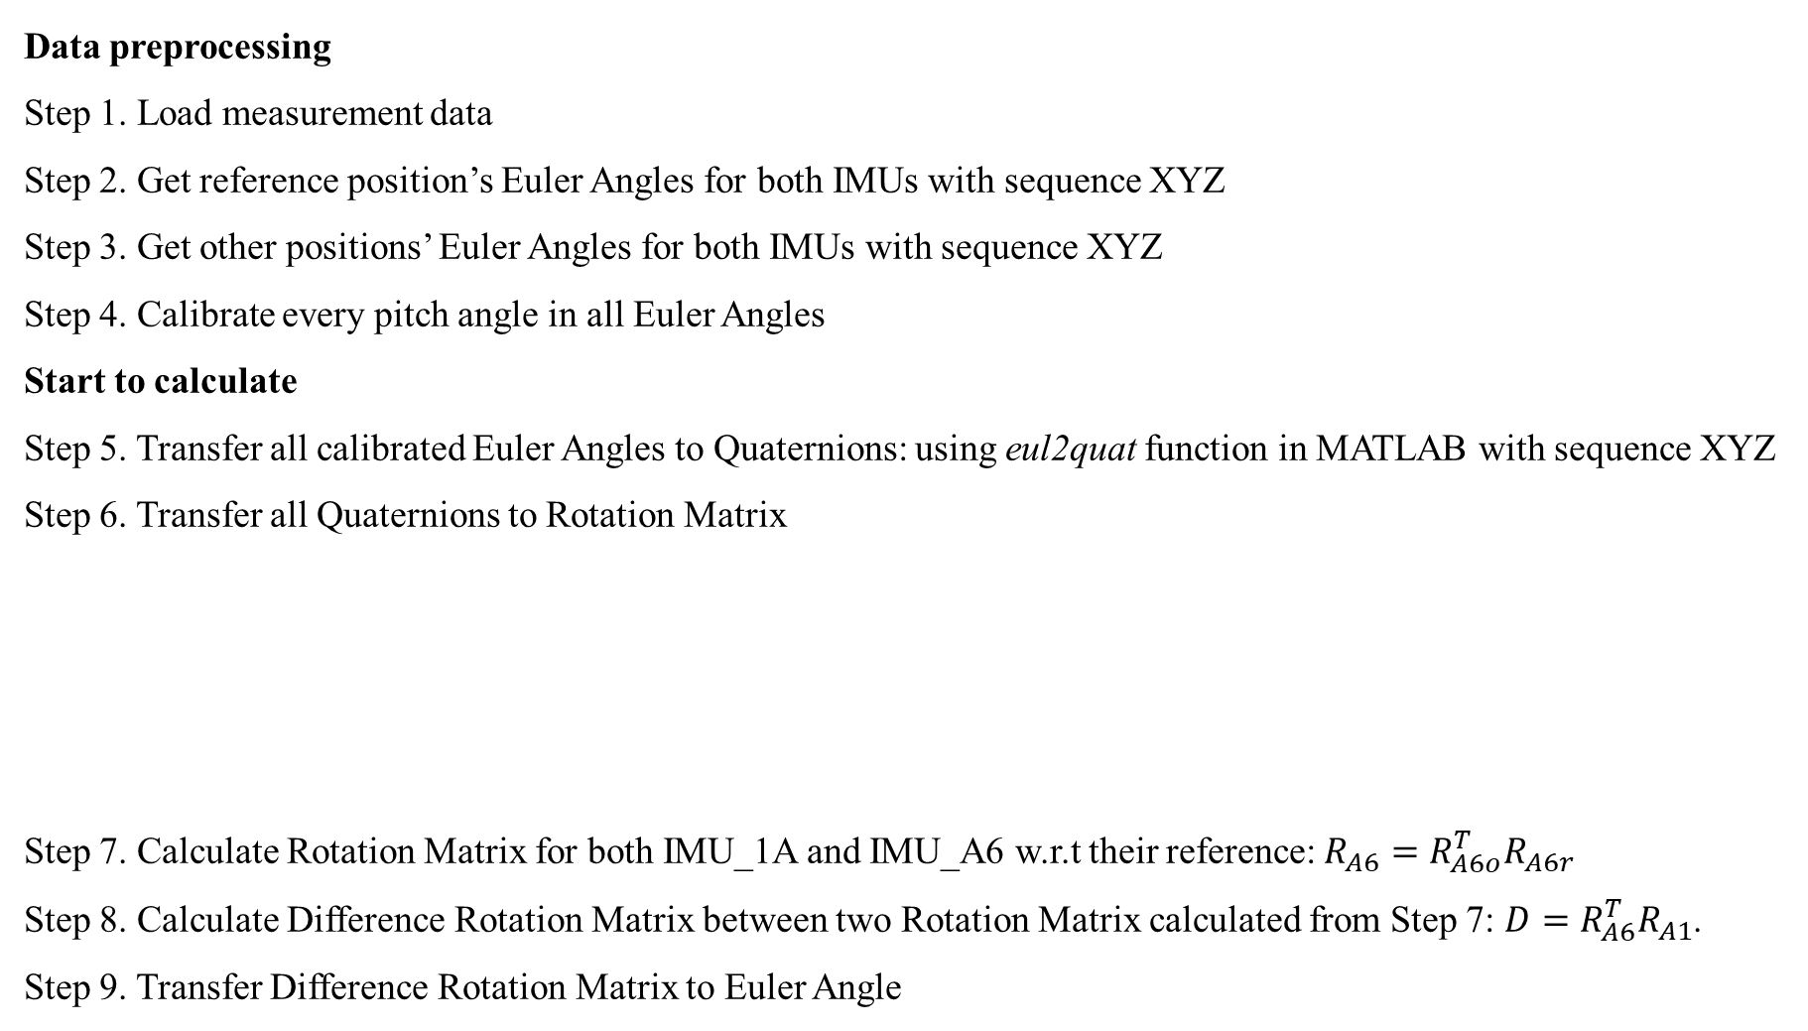
Mock OR data analysis
Data preprocessing
Step 1. Load measurement data
Step 2. Get reference position’s Euler Angles for both IMUs with sequence XYZ
Step 3. Get other positions’ Euler Angles for both IMUs with sequence XYZ
Step 4. Calibrate every pitch angle in all Euler Angles
Start to calculate
Step 5. Transfer all calibrated Euler Angles to Quaternions: using eul2quat function in MATLAB with sequence XYZ
Step 6. Transfer all Quaternions to Rotation Matrix
Step 7. Calculate Rotation Matrix for both IMU_1A and IMU_A6 w.r.t their reference: $R_{A6}=R_{A6o}^{T}R_{A6r}$
Step 8. Calculate Difference Rotation Matrix between two Rotation Matrix calculated from Step 7: $D=R_{A6}^{T}R_{A1}$.
Step 9. Transfer Difference Rotation Matrix to Euler Angle

Slide 3
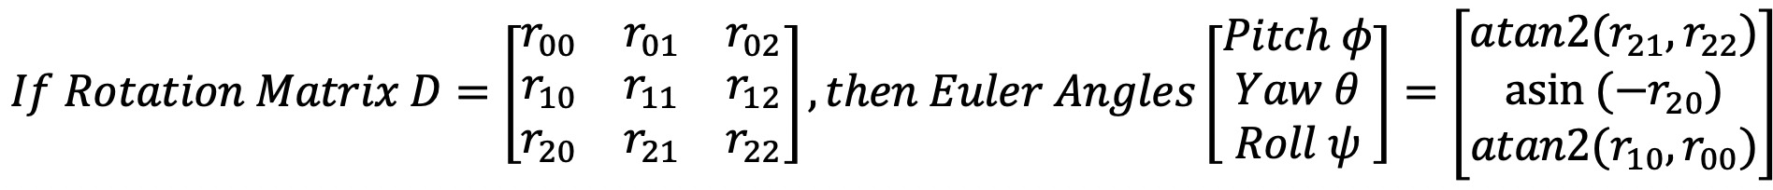
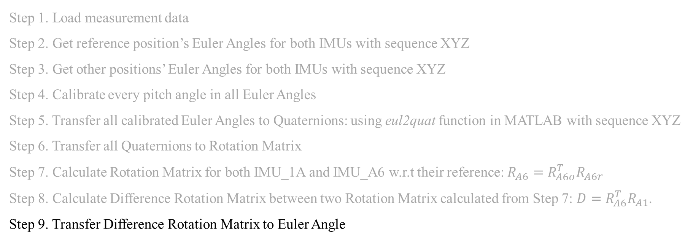
Mock OR data analysis
Step 1. Load measurement data
Step 2. Get reference position’s Euler Angles for both IMUs with sequence XYZ
Step 3. Get other positions’ Euler Angles for both IMUs with sequence XYZ
Step 4. Calibrate every pitch angle in all Euler Angles
Step 5. Transfer all calibrated Euler Angles to Quaternions: using eul2quat function in MATLAB with sequence XYZ
Step 6. Transfer all Quaternions to Rotation Matrix
Step 7. Calculate Rotation Matrix for both IMU_1A and IMU_A6 w.r.t their reference: $R_{A6}=R_{A6o}^{T}R_{A6r}$
Step 8. Calculate Difference Rotation Matrix between two Rotation Matrix calculated from Step 7: $D=R_{A6}^{T}R_{A1}$.
Step 9. Transfer Difference Rotation Matrix to Euler Angle

Slide 4
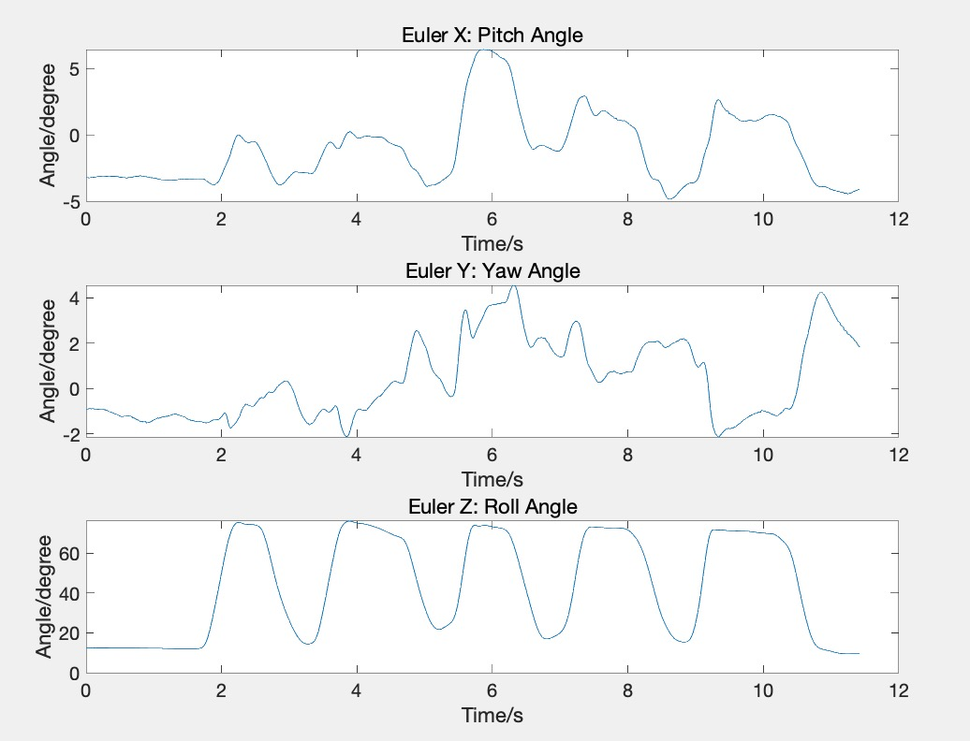
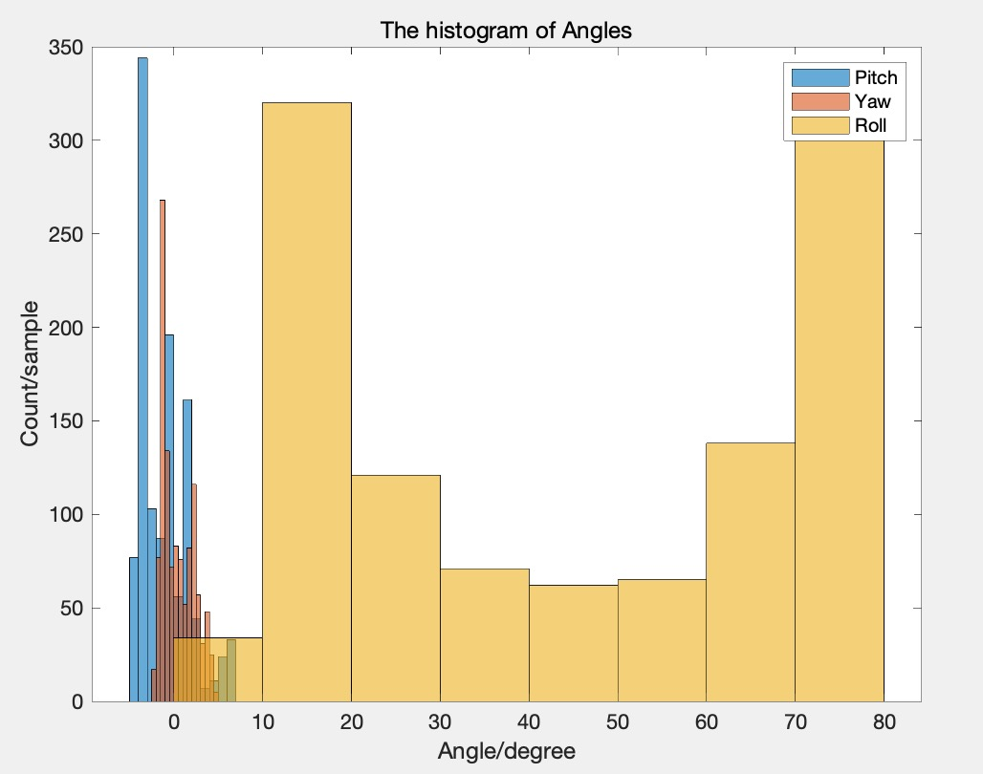
Mock OR data analysis

Slide 5
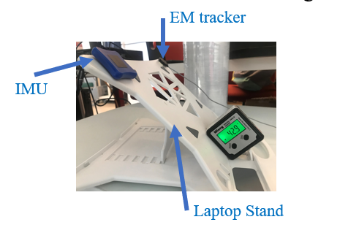
About Calibration
Because in our measurement, the total angle derived from quaternion is all come from the pitch component, so in order to calibrate the pitch angles we only need to calibrate the total angle.

